Slide 1
Animals Unit Activity 6.3: Functions of All Animals
Carbon: Transformations in Matter and Energy
Environmental Literacy Project Michigan State University
Notes:
Image Credit: Craig Douglas, Michigan State University

Slide 2
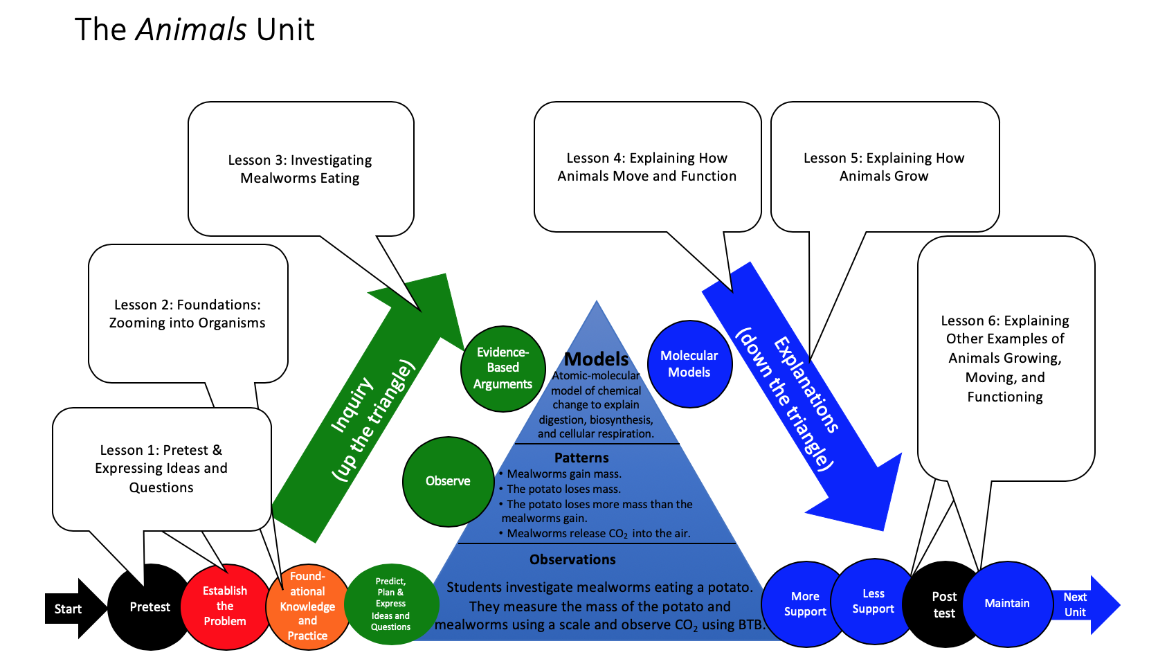
Unit Map
You are here
Notes:
Use the instructional model to show students where they are in the course of the unit.
Display slide 2 of the 6.3 Functions of All Animals PPT.

Slide 3
Scenarios of Animal Growth, Movement, and Functioning:
1. A man drinks 10 cans of soda a day and gains weight. Soda is mostly sugar and water.
How did drinking soda cause the man to add fat to his body?
2. A girl plays tennis for 2 hours and weighs less at the end of her match than at the beginning.
What energy left her body?
What kinds of atoms left her body?
Where did the energy and atoms come from?
Notes:
Have students try explaining new examples.
Display slides 3-5. Have students work to explain the scenarios on the slides about animal growth, movement, and function.
Have students discuss the scenarios with a partner and then discuss each as a class.
At this point in the unit, you will want to point out places where their explanations do not align with scientific explanations.

Slide 4
More Scenarios:
3. A bee uses energy to move its wings as it flies from flower to flower collecting nectar (the main ingredients in nectar are water and sugar).
How could the nectar from one flower help the bee to fly to the next flower?
4. A wolf gains weight by eating a rabbit.
Could a wolf gain five pounds by eating a four-pound rabbit?
Why or why not?
Notes:
Have students try explaining new examples.
Display slides 3-5. Have students work to explain the scenarios on the slides about animal growth, movement, and function.
Have students discuss the scenarios with a partner and then discuss each as a class.
At this point in the unit, you will want to point out places where their explanations do not align with scientific explanations.

Slide 5
More Scenarios:
5. A male penguin loses up to half his body weight while keeping his egg warm without eating.
Where did the energy come from to keep the egg warm?
What happened to the matter in the penguin when he lost weight?
Notes:
Have students try explaining new examples.
Display slides 3-5. Have students work to explain the scenarios on the slides about animal growth, movement, and function.
Have students discuss the scenarios with a partner and then discuss each as a class.
At this point in the unit, you will want to point out places where their explanations do not align with scientific explanations.

Slide 6
Explaining What Animals Have in Common
Here are three functions that all animals have in common. For each function, explain how animal cells work to accomplish that function.
All animals eat and digest food made mostly of water and large organic molecules and produce feces. What happens to food when they eat and digest it?
All animals grow. How do their cells do that?
All animals use energy to move and function. How do their cells do that?
Notes:
Have students explain the primary functions that animals have in common.
Display slide 6 of the 6.3 Functions of All Animals PPT. Tell students they will be constructing explanations that answer three questions about the functions of animals that are shared by all animals.
Option 1: Have students construct their explanations on 6.3 Functions of All Animals Worksheet in pairs. Students’ explanations can include words, illustrations, diagrams, and/or charts. Students may need additional sheets to answer each of the questions.
Option 2: Have students construct their explanations in a PowerPoint presentation in pairs for each of the questions.
Option 3: Have students construct their explanations on a poster in pairs or small groups.
For all options, display slide 7 of the PPT and remind students that good answers to questions about animal cells should address each of the four numbered questions of the Three Questions Poster (or Handout).

Slide 7
Good answers to questions about animal cells
Answer each of the questions (numbered 1-4) below to explain how matter and energy move and change in a system. Note that matter movement is addressed at both the beginning (1) and end (4) of your explanation.
Question
Where are molecules moving?
How do molecules move to the location of the chemical change?
How do molecules move away from the location of the chemical change?
Evidence We Can Observe
Moving solids, liquids, and gases are made of moving molecules.
A change in mass shows that molecules are moving.
Rules to Follow
All materials (solids, liquids, and gases) are made of atoms that are bonded together in molecules.
Scale: The matter movement question can be answered at the atomic-molecular, cellular, or macroscopic scale.
Question
How are atoms in molecules being rearranged into different molecules?
What molecules are carbon atoms in before and after the chemical change?
What other molecules are involved?
Evidence We Can Observe
BTB can indicate CO₂ in the air.
Organic materials are made up of molecules containing carbon atoms:
• fuels • foods
• living and dead plants and animals
decomposers
Rules to Follow
Atoms last forever in combustion and living systems.
Atoms can be rearranged to make new molecules, but not created or destroyed.
Carbon atoms are bound to other atoms in molecules.
Scale: The matter change question is always answered at the atomic-molecular scale.
Question
What is happening to energy?
What forms of energy are involved?
What energy transformations take place during the chemical change?
Evidence We Can Observe
We can observe indicators of different forms of energy before and after chemical changes:
• light energy • heat energy
• chemical energy stored in organic materials
• motion energy
Rules to Follow
Energy lasts forever in combustion and living systems.
Energy can be transformed, but not created or destroyed.
C-C and C-H bonds have more stored chemical energy than C-O and H-O bonds.
Scale: The energy change question can be answered at the atomic-molecular, cellular, or macroscopic scales.
Notes:
Have students explain the primary functions that animals have in common.
Display slide 6 of the 6.3 Functions of All Animals PPT. Tell students they will be constructing explanations that answer three questions about the functions of animals that are shared by all animals.
Option 1: Have students construct their explanations on 6.3 Functions of All Animals Worksheet in pairs. Students’ explanations can include words, illustrations, diagrams, and/or charts. Students may need additional sheets to answer each of the questions.
Option 2: Have students construct their explanations in a PowerPoint presentation in pairs for each of the questions.
Option 3: Have students construct their explanations on a poster in pairs or small groups.
For all options, display slide 7 of the PPT and remind students that good answers to questions about animal cells should address each of the four numbered questions of the Three Questions Poster (or Handout).

Slide 8
Share Your Answers
How did you explain each of the three functions?
Do your explanations answer the Three Questions?
How do your answers compare to your classmates?
Notes:
Allow students to share their explanations with the class.
Display slide 8 of the 6.3 Functions of All Animals PPT. Provide students an opportunity to share their explanations with the class.
Decide how you will have students present depending on the option you chose in step 6 and the needs of your students and classroom.
If students did option 1, they could verbally share their explanations or share them with the class using a document camera.
If student did option 2, they could present their PPT to the class.
If students did option 3, they could share their posters with the whole class or you could organize a gallery walk in which students circulate the classroom and view the posters.
Have students share feedback on their classmates’ explanations as to if the explanations addressed each of the Three Questions.

Slide 9
How have your ideas changed?
Gather together your process tools for the unit (Expressing Ideas Tool, Predictions Tool, & Evidence-Based Argument Tool, Explanations Tool).
How have your ideas changed related to:
Scale?
Movement?
Carbon?
What do you know now about how animals grow, move, and function that you didn’t know before this unit?
Notes:
Lead a discussion about how student ideas have changed over time.
Display slide 9 of the PPT. Have students consider how their ideas changed with regard to scale, movement, and carbon. What do they know about how animals grow and move now that they didn’t know before this unit?
(Optional) Have students complete the Big Idea Probe: What Happens to the Fat? for the final time.
If you decided to use the Big Idea Probe: What Happens to the Fat?, have students complete it and share their ideas again. Have students discuss how their ideas have changed throughout the unit. See Assessing the Big Idea Probe: What Happens to the Fat? for suggestions about how to use the Big Idea Probe.

Slide 10
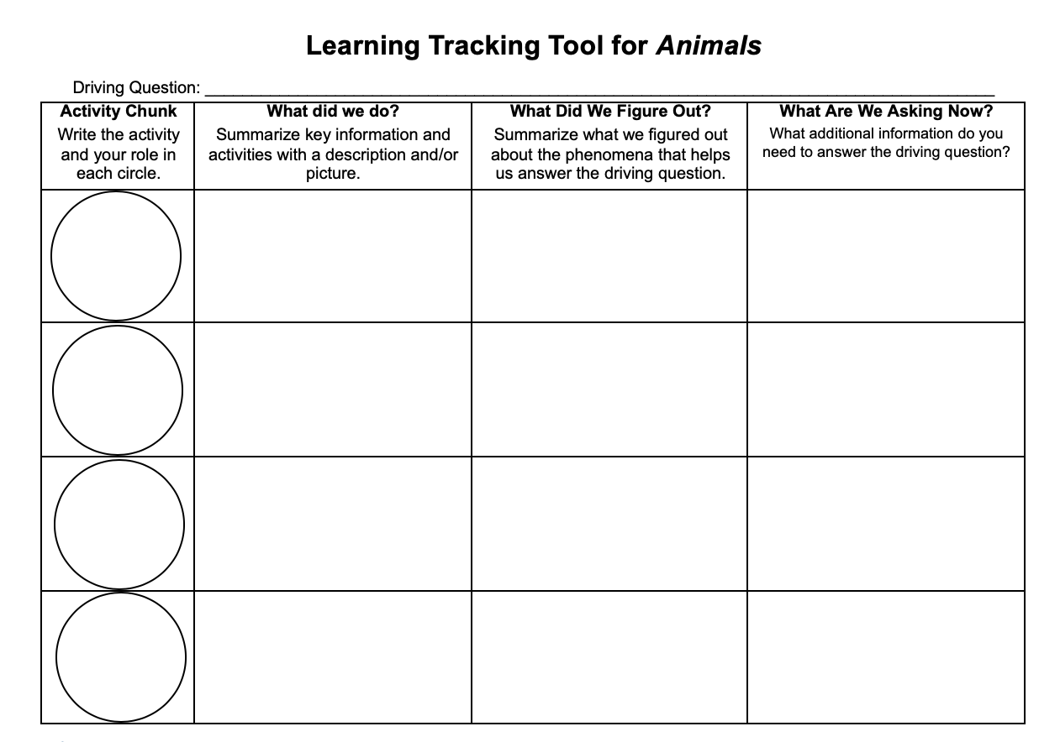
Learning Tracking Tool
Record the activity chunk name “Explaining other Examples,” and your role in the first column.
Discuss what you did during the activity chunk and record your ideas in the column, “What Did We Do?”
Discuss with your classmates what you figured out will help you to answer the unit driving question. Record your ideas in the column “What Did We Figure Out?”
Discuss questions you now have related to the unit driving question and record them in the column “What Are We Asking Now?”
Notes:
Have a discussion to complete the Learning Tracking Tool for this activity.
Show slide 10 of the 6.3 Functions of All Animals PPT.
Pass out a Learning Tracking Tool to each student.
Explain that students will add to the tool after activities to keep track of what they have figured out that will help them to answer the unit driving question.
Have students write the activity name in the first column, "Explaining Other Examples” and their role, Explainer.
Have a class discussion about what students did during the activity. When you come to consensus as a class, have students record the answer in the second column of the tool.
Have a class discussion about what students figured out during the activity that will help them in answering the unit driving question. When you come to consensus as a class, have students record the answer in the third column of the tool.
Have a class discussion about what students are wondering now that they have answered the unit driving question. Have students record the questions in the fourth column of the tool.
Example Learning Tracking Tool
Activity Chunk: Explaining Other Examples, Explainer
What Did We Do? Practice explaining digestion, biosynthesis, and cellular respiration in other animals, and take the unit posttest.
What Did We Figure Out? All animals use the same carbon-transforming processes (digestion, biosynthesis, and cellular respiration) to move, grow, and function.
What Are We Asking Now? How do plants grow, move, and function?

